Slide 1
Razor Pages

Slide 2
Content
A little bit of history repeating
Razor Pages
Page only & Razor syntax
Routes
PageModel & bindings
Layout & sections ➔ UNIZO
REST services
Partials
ViewComponents
Taghelper
Form
Select lists
Validation
Custom
Lifecycle & filters
UNIZO – reallife casus

Slide 3
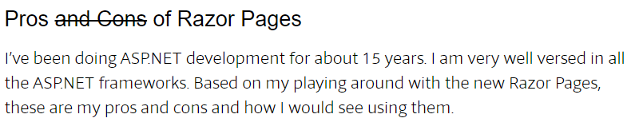
A little bit of history repeating

Slide 4
Scope
We are talking about server-side web development
SPA’s is ‘rich client development in the browser’ (== WPF on the desktop) + webservices

Slide 5
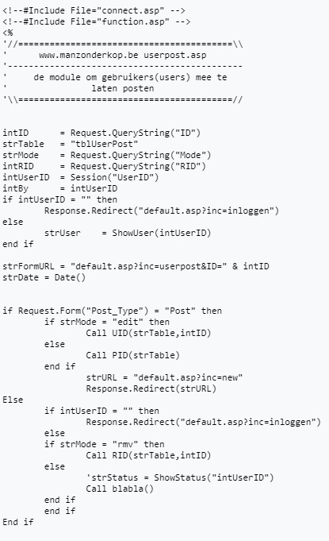
Classic ASP
Concepts:
Sequental rendering
https://github.com/tonywong1p/OpenShop
Pro:
Really fast
Whay ou see is what you get
Limited
Classes / COM+
Con:
No ‘base class library’
VBScript

Slide 6
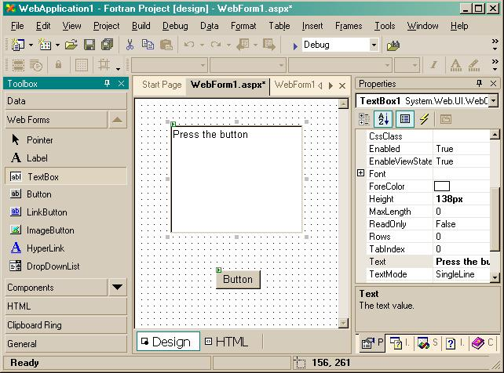
Webforms
Concepts:
PostBack
ViewState
Pro:
Componentized
Con:
The SOAP of the web
Full page reload

Slide 7
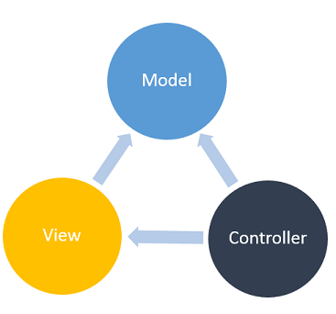
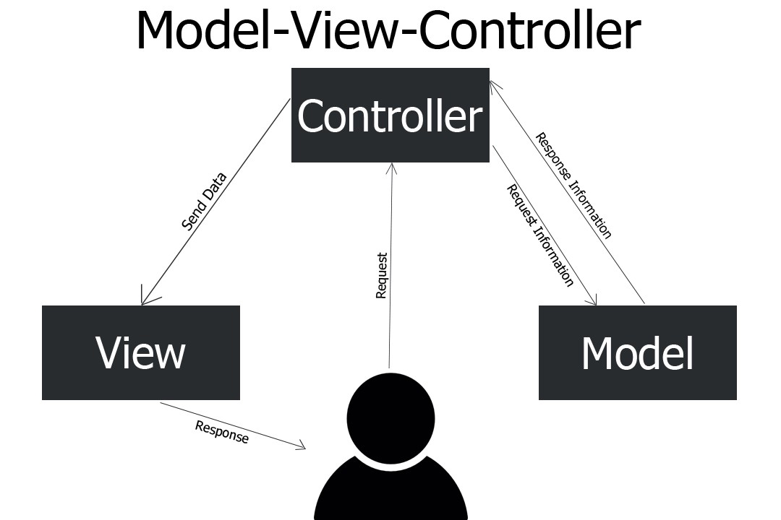
ASP.NET MVC
Concepts:
Pro:
Clear structure
HTTP REST possible
Shared components
Con:
‘Model’ wrong interpreted
‘only used for binding’
Overhead when no reuse
Not really components

Slide 8
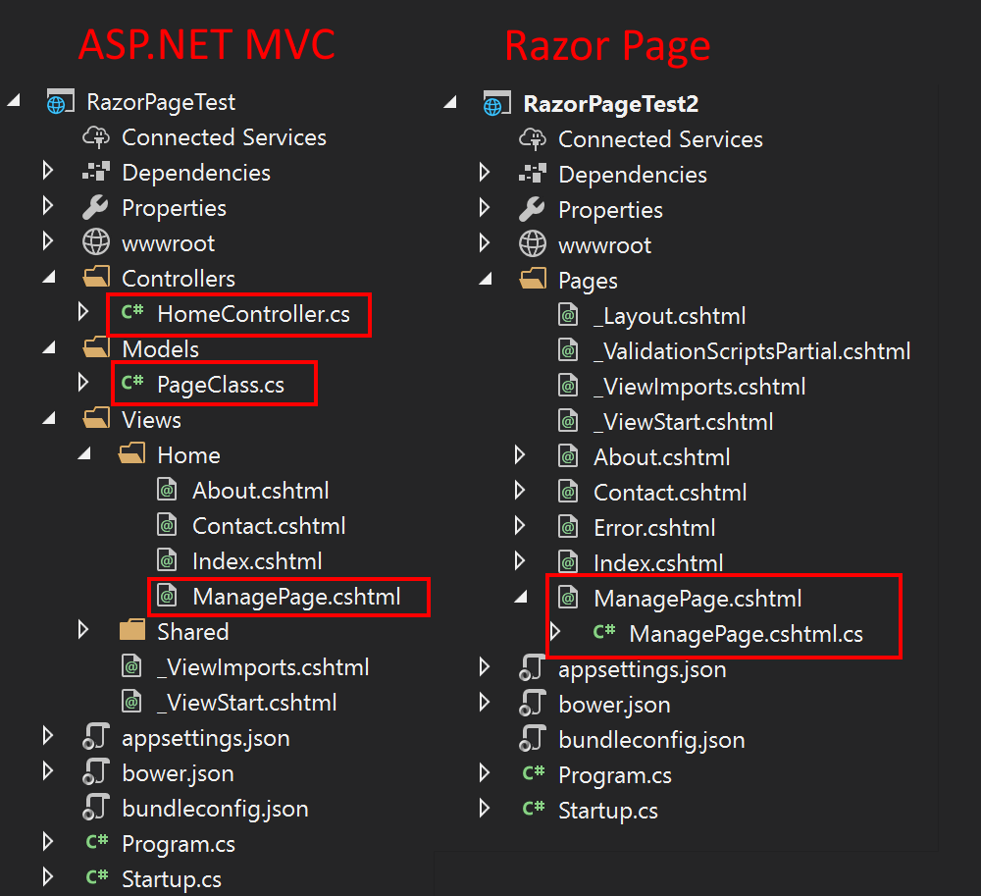
ASPNETCORE - Razor Pages
Concepts:
Sequental rendering
Really fast
What you see is what you get
Pro:
Easy
(M)VC as it should be
Area’s
Componentized
Con:
?

Slide 9
Razor Pages

Slide 10
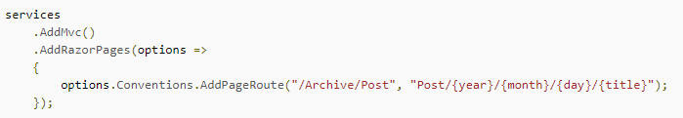
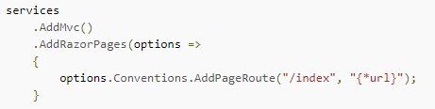
Advanced routing

Slide 11
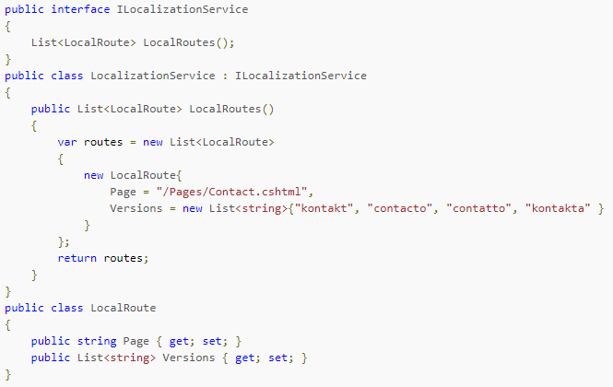
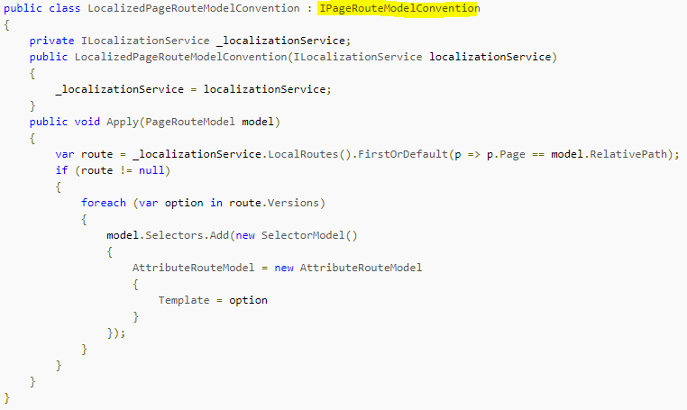
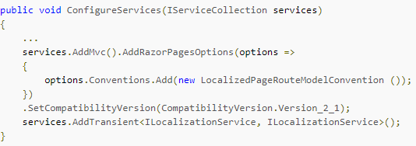
Advanced Routing

Slide 12
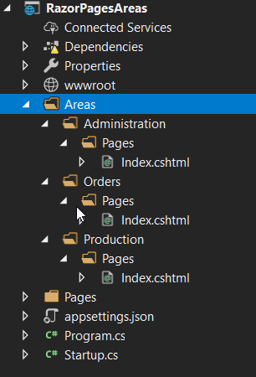
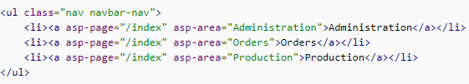
Area’s

Slide 13
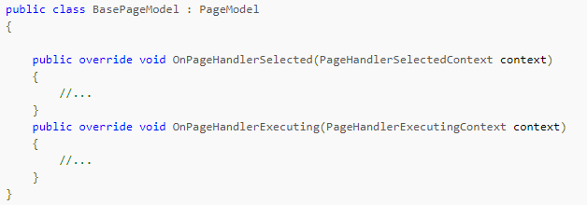
Filters

Slide 14
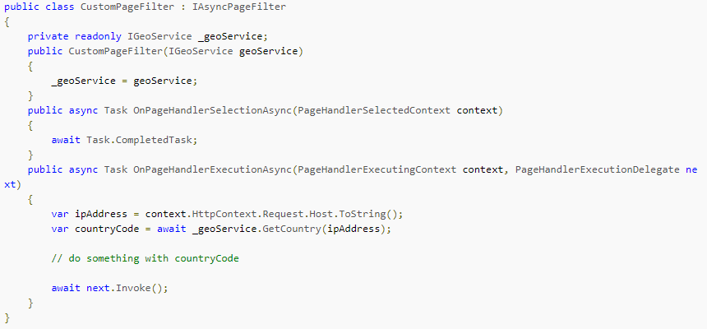
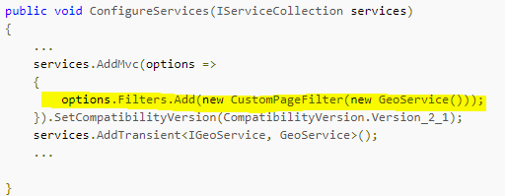
Filters II

Slide 15

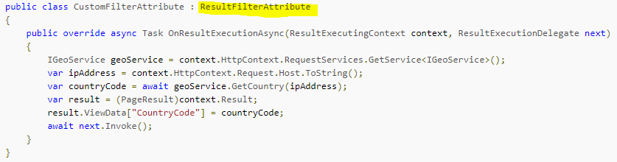
Filters III

